Slide 1

Project Managers in the Engineering Classroom
Samuel Malachowsky
Rochester Institute of Technology - Software Engineering
Notes:
What I want to communicate: Describe the context, the implementation, some results, and a strong conclusion and future work
Basic Structure:
Introduction
Problem Statement
About the class
Changes made and why/how
PMs in the Classroom
Results
Questions
Introduction:
About Me
PMP
Exited industry because of a passion for business leadership and engineering process and its practical application (classroom and real)
Currently promoting the field (PM) in academia because I believe the very real benefits will be articulated in industry
Project Management is a somewhat young discipline, similar in many ways to software engineering – both are moving towards a more established ‘right way to do it’ like accounting or electrical engineering
Also care about the business side: courses include a strong leadership and team component as well as ethics, etc.
Before I get started: In a few words, what are some of the biggest problems you have encountered with teams in your classes?

Slide 2
Problem Statement
Coursework-centered Teams
Unbalanced Teams
Lots of Project and Process, but no Product
PM Role Undefined
Little Experience in PM-team exchanges
Repetitive, unengaged Final Presentations
“Lack of coordination, poor communication, misunderstanding roles”
Notes:
Coursework-centered Teams
Students are good at forming teams for efficiently completing coursework, but what about actual projects?
Unbalanced Teams (super and slacker team)
Students tend to self-select in this way, and instructors don’t fare much better
Are unbalanced teams realistic/do they provide real value?
Lots of Project and Process, but no Product
The opposite of many other courses/programs. No product can mean no satisfaction (process and project, from the engineering perspective, exist to fulfill a better product)
Project Manager Role
The course has always had a team project, but the PM role was either undefined, assumed informally by a team member, assumed by the instructor, or some mix of these. I’ve always felt that the instructor should be more of a project sponsor (define this)
Little Practical Experience in PM-team exchanges
It’s all theory, little practice. How does one lead with no “real” authority?
Repetitive, unengaged Final Presentations
All teams did the same assignment, so the presentation is the same for all of them.
As one student put it in a survey when asked what problems they typically encounter in group projects: “Lack of coordination, poor communication, misunderstanding roles”

Slide 3
Process and Project Management
Required by all Software Engineering Majors
Fundamentals of Engineering Process and Project Management
Project Functions
Software Engineering Models and Methodologies
Project Management Practices
Software Engineering Concepts
Becoming a better project leader (PM) or team member
Class Time: Lectures 50%, Group Activities 25%, Main Project 25%
Notes:
A little context: The Course
Required by all Software Engineering Majors
Close to their first Co-Op (right before or after)
Fundamentals of Engineering Process and Project Management
Project Functions - Risk Management, Communications Management, Team/Conflict Management, Change Management
Software Engineering Models and Methodologies - Waterfall, Spiral, Evolutionary Prototyping, Personal/Team Software Process (PSP/TSP), Rational Unified Process (RUP), Agile Principles and Scrum, Process Maturity Models
Project Management Practices - Planning, Estimating/Scheduling, Measurement/Metrics, Stakeholder Management, Ethics
Software Engineering Concepts - Testing, Quality, Product Metrics
Becoming a better project leader (PM) or team member

Slide 4
The Main Project
Project
Creation and evaluation of Project Artifacts
Modified Project (+)
Give the students a chance to participate in a more realistic Project Management scenario
Add a non-artifact product
Increase engagement/variety in the final presentation
“I think this was the best group project I've ever been a part of. The PM was great at getting everyone to meetings, as well as assigning work to the various members of the group.”
Notes:
A little context: The Project that was Modified
Project
Creation and evaluation of Project Artifacts
Project Plan and basic artifacts such as a risk register – Goal: Any Technical PM could pick it up and execute the project
Scenarios vary by semester – this last semester it was a neighborhood security system project
Updated Project
Give the students a chance to participate in a more realistic Project Management scenario:
As a PM or team member
Some more advanced parts such as cross-project coordination
More than just the artifacts (a temptation in these courses)
Artifacts are important (and even a major focus of the course) but not everything
Add a non-artifact product
The final presentation becomes the product – in some ways similar to real life (business)
Increase engagement/variety in the final presentation
Student Quote Leading into next slide: “I think this was the best group project I've ever been a part of. The PM was great at getting everyone to meetings, as well as assigning work to the various members of the group.”

Slide 5
PM’s In the Classroom
Appropriate Timing
After 1st midterm – 1/3 of the way through the class
Realistic Responsibilities
Differing Experiences
Most interactions are public
Each group sees 2 other groups’ artifacts
Team member/PM interactions
What is it like to work as/with a PM?
“I really like how the project managers volunteered for the position, because it meant that they were willing to put forth the effort to manage the group, and as a result I felt more motivated to participate as a member.”
Notes:
Appropriate Timing
Potential PMs are aware well in advance, and are asked to review the PM activity guide as well as compile potential team members
PMs are selected 1/3 through the class (after 1st midterm – helpful for statistical grade measurements) via volunteering by show of hands
Groups have mixed through assignments and activities
Realistic Responsibilities (according to the PM guide on the course website)
Coordinate team activities, meetings, and deliverables for the duration of the term starting approximately week 6
Meet with the professor at the start or during class to discuss individual group dynamics/activities or Cross-PM coordination
Meet with other Project Managers outside of class to conduct Cross-PM coordination (2x w/ minutes delivered to professor)
Ensure that team deliverables reflect the available time, resources, and given scope
Fill out peereval for other PMs (in addition to standard team peereval)
Its impossible to ensure each team member has the same experience (they don’t anyways)
PM interactions are public (PM selection – elaborate on how it works – “PM Volunteers” ¼ to 1/5 of the class, etc.) PM grades do not significantly differ from those of team members
Exceptions: team selection, and cross-PM meetings (elaborate on those)
Cross-group evaluation - worksheet-guided evaluation with each of the first two drafts: “Maybe we should do this in our paper”
Team member/PM interactions
What is it like to work with a PM (good or bad), or
What is it like to work as a PM?
Student Quote: “I really like how the project managers volunteered for the position, because it meant that they were willing to put forth the effort to manage the group, and as a result I felt more motivated to participate as a member.”

Slide 6
Results
More Interest
In the project activity as well as Project Management
Better Balance
In schedule and team makeup
Increased Engagement
Teams feel and are treated as units
Final Presentations
Less repetition, more buy-in by presenters and audience
“I think the use of Project Managers really helped highlight the things we were learning in this class, at least that was the experience I had in my group. When you have a proactive PM who is good about getting people to show up to meetings and actually getting their work done, it becomes much easier to complete a project, and do it well.”
Notes:
More interest:
According to a survey, 75-90% of students felt that they were more successful, had improved group dynamics, and were more satisfied with the course due to transition to PM-led teams
Student Quote: “I think the use of Project Managers really helped highlight the things we were learning in this class, at least that was the experience I had in my group. When you have a proactive PM who is good about getting people to show up to meetings and actually getting their work done, it becomes much easier to complete a project, and do it well.”
Better Balance:
The group leader isn’t always the one most motivated to score well, nor is one person doing all of the work (PMs are 52nd percentile for grade on the first exam – before the project starts). Procrastination is no longer the default due to lack of group coordination – it’s now the PMs job.
Teams are more balanced in terms of grade and performance (data is in the paper), chosen gym-class style and via PM-to-PM negotiation
Increased engagement:
Teams have willing leaders and feel a connection to other teams (PM coordination)
I can call on a team to answer a question rather than singling out an individual
Attendance becomes a responsibility to the team (explain)
Better Final Presentations
Positive collaboration between leaders yields superior (or at least interesting) results
More depth rather than breadth has been an overarching result (less redundancy, more interesting detail)
Examples of what PM teams have come up with:
Choosing to concentrate on different areas of study presentation-to-presentation (diversification, less boring)
Contrasting approaches (standard presentation format, but directly referencing other teams’ approaches)
Combining all slides into one deck (remove unfairness in order, better flow and mechanics)
Timing each other’s presentations w/ cues, ensuring that all of their team members are paying attention, checking other team’s presentations vs. the rubric (addressing the rubric)
Prerecording the presentation, eliminating errors through editing
Creative ways of presenting: Plays, TV show formats, etc. – Discuss what’s on the next slide

Slide 7
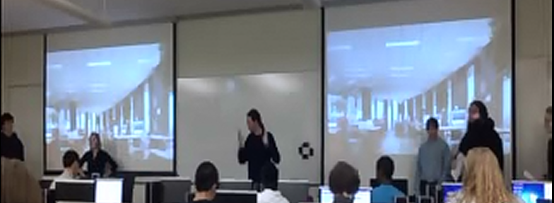
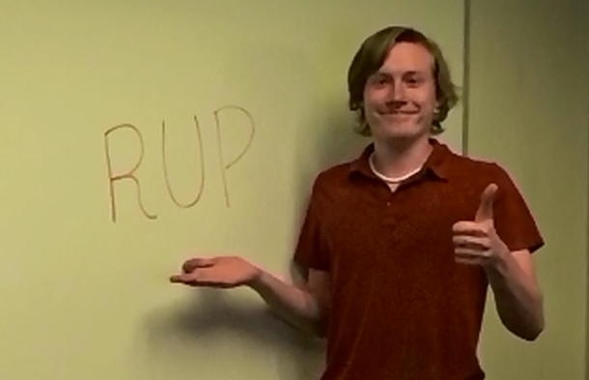
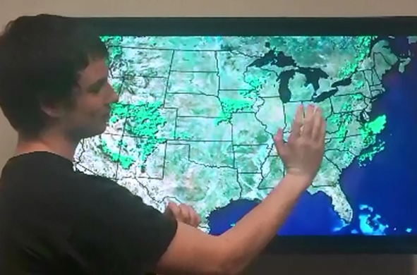
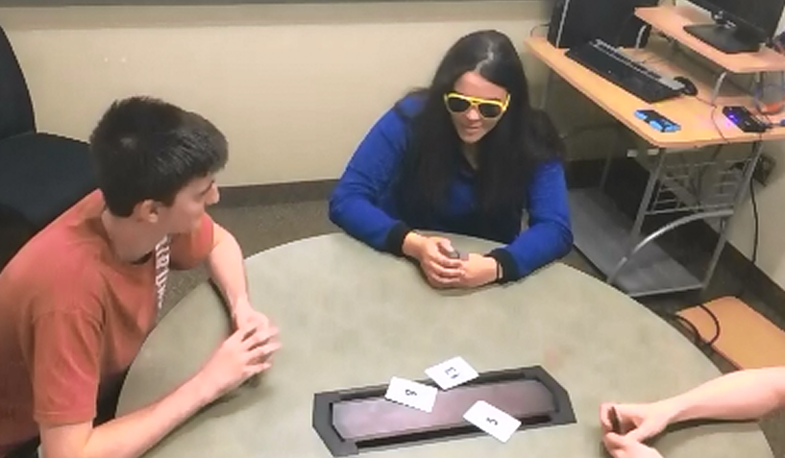
Results
Agile vs. Plan Driven “Smackdown”
Nova: The Magic of RUP
Project Risk Report
World Series of Planning Poker
Notes:
It is my hope that you can use some of what you have heard here as well as in the paper to improve classroom experience.
Questions/Discussion?

Slide 8
Thanks… Questions?
Samuel A Malachowsky
Rochester Institute of Technology
Software Engineering
samvse@rit.edu
TeachingSE.com

